Slide 1
CIVL 4210 - Advanced Construction with AI and Robotics
Tutorial: Biomechanical simulation and exoskeleton simulation
Prof. YU, Yantao
XIE Minshan
The Hong Kong University of Science and Technology (HKUST)

Slide 2
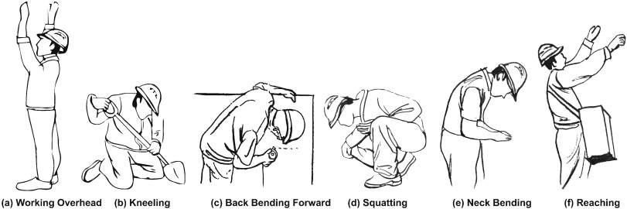
Introduction
Construction work involves high physical demand and awkward postures

Slide 3
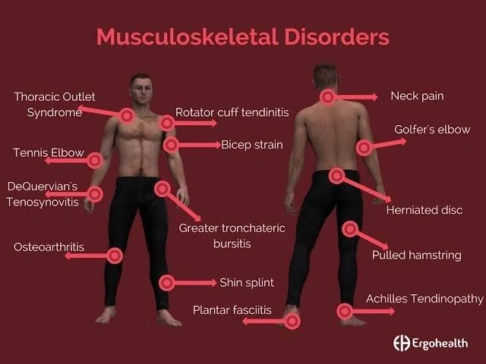
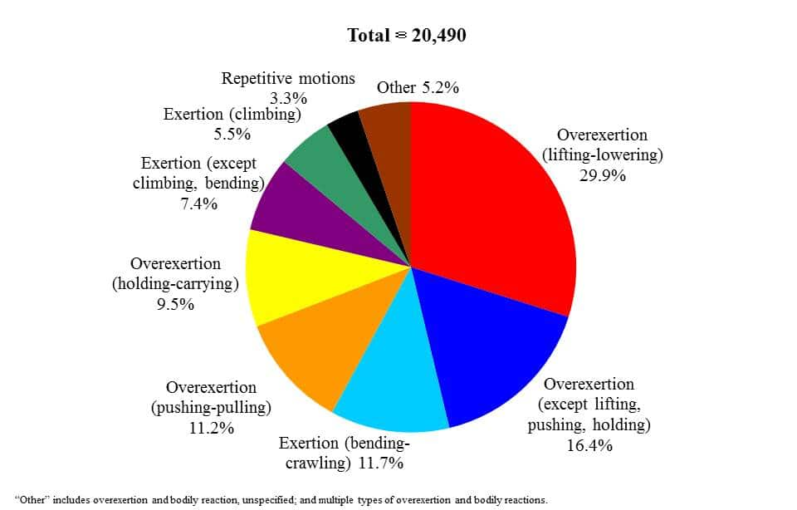
Introduction
Work-related musculoskeletal disorders (WMSDs) are physical conditions that cause pain in muscle and joints
Major causes of WMSDs are internal physical strains, but how do we monitor them?

Slide 4
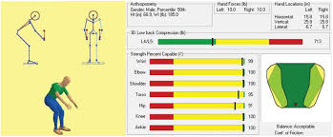
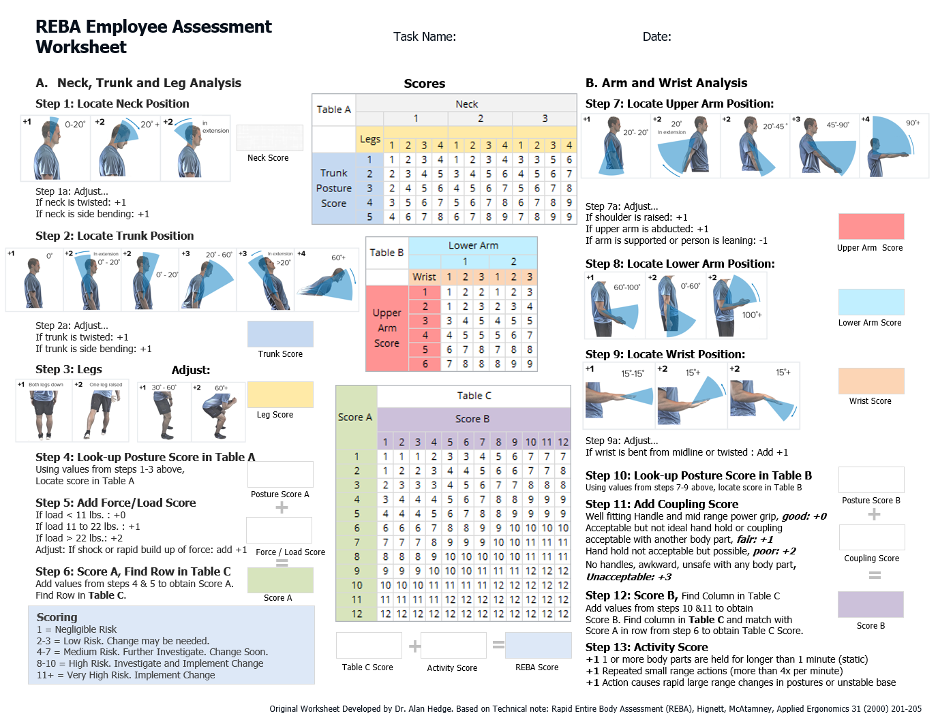
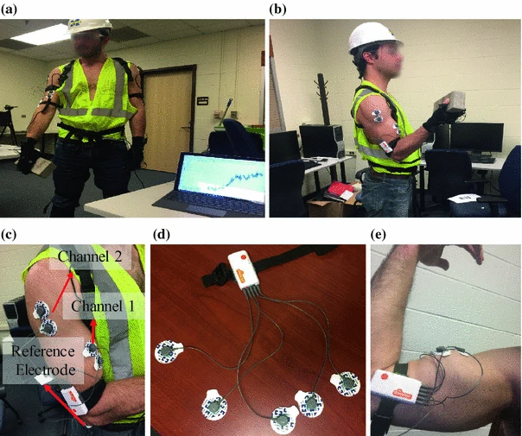
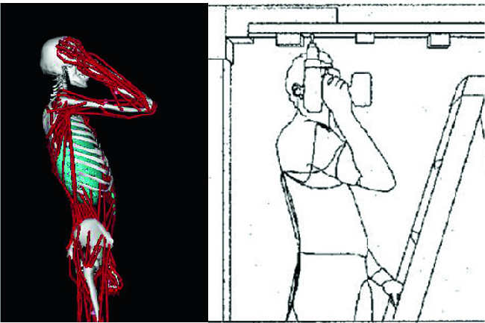
Introduction
Survey-based approach
EMG-based approach
👎 Empirical, subjective
👎 Joint level
👍 Direct and accurate
👎 Only feasible in lab
👍 Muscle level
👎 Complex to conduct

Slide 5
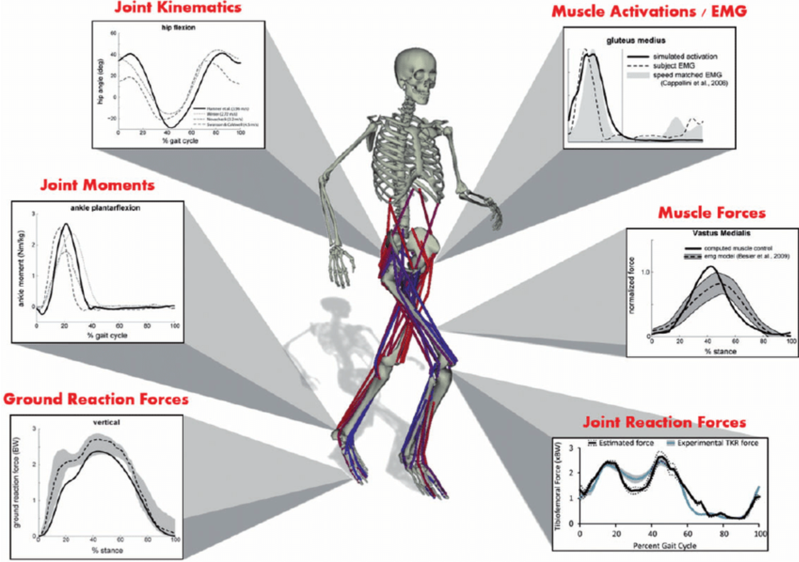
Introduction to Biomechanics
Biomechanics is the study of how mechanical forces are applied to and generated by human, and the effects of these forces on human
What does biomechanics study:
Internal/external forces act on body
How biological tissues respond to loading
How different body parts interact with each other
Application of biomechanics:
Sports performance
Injury prevention
Rehabilitation
Biomedical devices
Ergonomics

Slide 6
Overview
Session 1: Introduction to OpenSim
Objectives:
Learn basics of OpenSim
Hands-on Activities:
Run basic simulations on OpenSim using examples
Session 2: Introduction to OpenSim API
Objectives:
Learn basics of OpenSim Python API
Hands-on Activities:
Run basic simulations with OpenSim API
Session 3: Simulate human-exoskeleton
Construct human-exoskeleton through OpenSim Python API
Run simulations on human-exoskeleton system

Slide 7
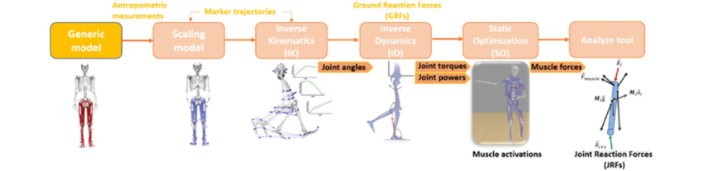
Workflow of OpenSim simulation
For more info, visit: User's Guide - OpenSim Documentation - OpenSim

Slide 8

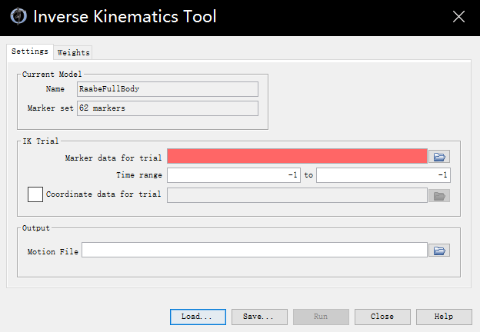

Inverse kinematics in OpenSim
IK inputs and outputs
How inverse kinematics work
Obtain a kinematic trajectory (joint angles) that minimizes the distance between the model-defined markers and marker trajectories obtained from motion capture experiment

Slide 9
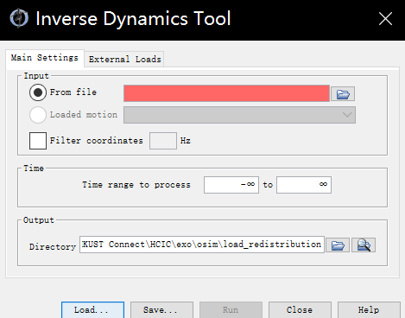


Inverse kinematics in OpenSim
ID inputs and outputs
How inverse dynamics work
Positional parameters
Generalized forces
System mass matrix
Centrifugal force
Yield the net joint moments/torques and forces required to create the motion
Gravitational force

Slide 10
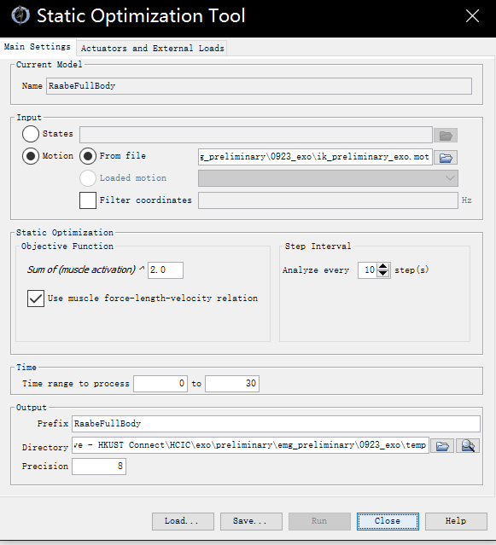

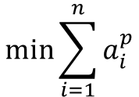
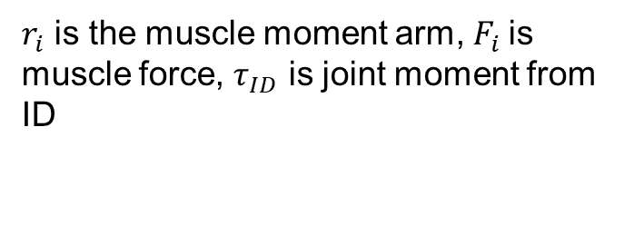

Static Optimization in OpenSim
SO inputs and Outputs
At each time step, solve:
$$\min{\sum_{i=1}^{n}{a_{i}^{p}}}$$
$where a_{i}^{}$ is the muscle activation
Subject to joint moment constraint
$$\sum_{i=1}^{n}{r_{i}}F_{i}=τ_{\text{ID}}$$
$r_{i}$ is the muscle moment arm, $F_{i}$is muscle force, $τ_{ID}$ is joint moment from ID

Slide 11
Overview
Session 1: Introduction to OpenSim
Objectives:
Learn basics of OpenSim
Hands-on Activities:
Run basic simulations on OpenSim using examples
Session 2: Introduction to OpenSim API
Objectives:
Learn basics of OpenSim Python API
Hands-on Activities:
Run basic simulations with OpenSim API
Session 3: Simulate human-exoskeleton
Construct human-exoskeleton through OpenSim Python API
Run simulations on human-exoskeleton system

Slide 12
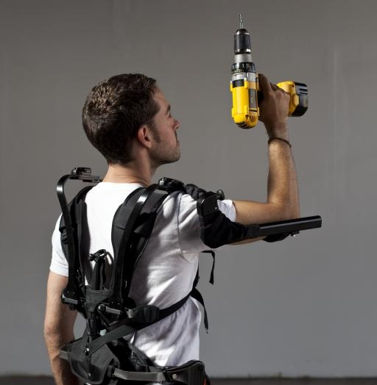
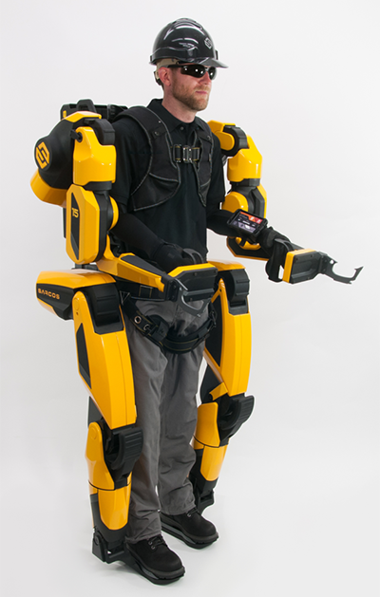
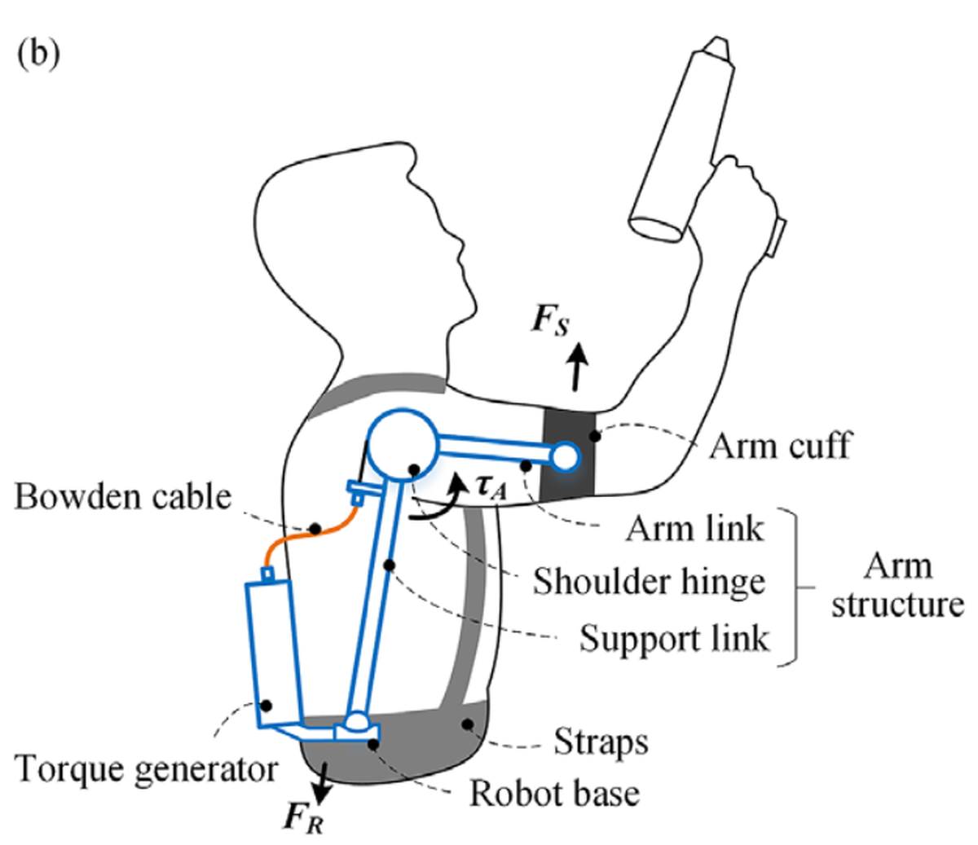
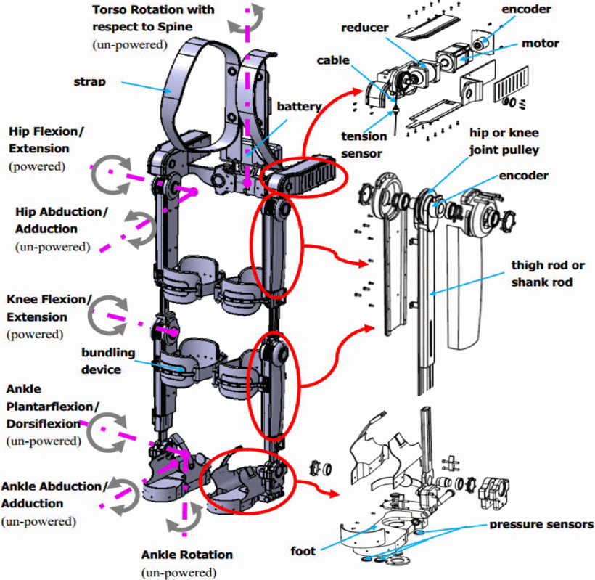
Introduction
WMSD mitigation - exoskeletons
Passive exoskeletons
Active exoskeletons
Exoskeletons can reduce physical burden of construction tasks
But how to evaluate the impact of exoskeletons to human biomechanical system?

Slide 13
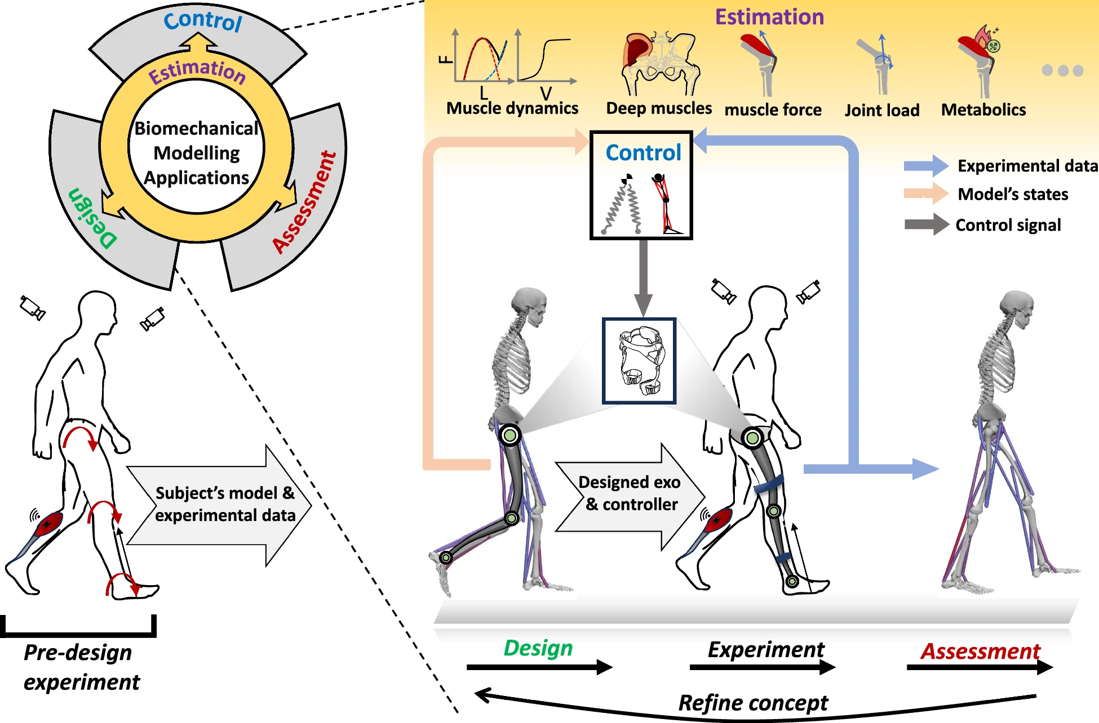
Human-exoskeleton simulation in OpenSim
Use of biomechanical simulation in exoskeleton applications
Design
Control
Assessment
Estimate
Firouzi et al, 2025

Slide 14
Biomechanical simulation for exoskeleton assessment
Exoskeleton TRY ON
Build a simple OpenSim-exoskeleton model through OpenSim Python API

Slide 15
Assignment
Plot the moment on ‘lumbar_bending’ and muscle force on ‘ercspn_r’ with spring stiffness 4000 N/m

